Slide 1
Cryptography: Block Ciphers
Zaobo He

Slide 2
Primitive Operations for Strong Cipher
Shannon: there are two primitive operations with which strong encryption algorithms can be built:
Confusion: An encryption operation where the relationship between key and ciphertext is obscured. E.g., substitution.
Diffusion: An encryption operation where the influence of one plaintext symbol is spread over many ciphertext symbols with the goal of hiding statistical properties of the plaintext. E.g., permutation.

Slide 3
Outline of today’s lecture
Symmetric key cryptography is classified into two types:
Block Ciphers
Stream Cipher

Slide 4
Block Ciphers and Stream Ciphers
Block ciphers partition plaintext into blocks and encrypt each block independently (with the same key) to produce ciphertext blocks.
A stream cipher generates a keystream and encrypts by combining the keystream with the plaintext, usually with the bitwise XOR operation.
We will focus mostly on Block Ciphers.

Slide 5
Block Ciphers and Stream Ciphers
A block cipher takes a block of plaintext bits and generates a block of ciphertext bits, generally of same size.
The size of a block is fixed in the given scheme.
Block cipher uses both confusion and diffusion while stream cipher relies only on confusion.
The usual size of the block could be 64 or 128 bits in the Block cipher. As against, 1 byte (8 bits) at a time is converted in the stream cipher
Block cipher uses the same key to encrypt each block while stream cipher uses a different key for each byte.
Notes:
Block cipher uses ECB (Electronic Code Book) and CBC (Cipher Block Chaining) algorithm modes. On the contrary, Stream cipher uses CFB (Cipher Feedback) and OFB (Output Feedback) algorithm modes.

Slide 6
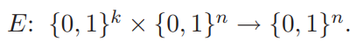
What is a block cipher?
n bits
n bits
Block of plaintext
E
Block of ciphertext
Key
k bits

Slide 7
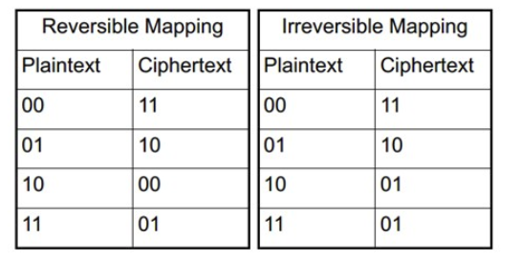
Block Cipher Principles
n-bit block cipher takes n-bit plaintext and produce n bit ciphertext
Encryption must be reversible (decryption possible)
Each plaintext must produce unique ciphertext block

Slide 8
Block ciphers
The Data Encryption Standard (DES)
A symmetric-key block cipher published by the National Institute of Standards and Technology (NIST).

Slide 9
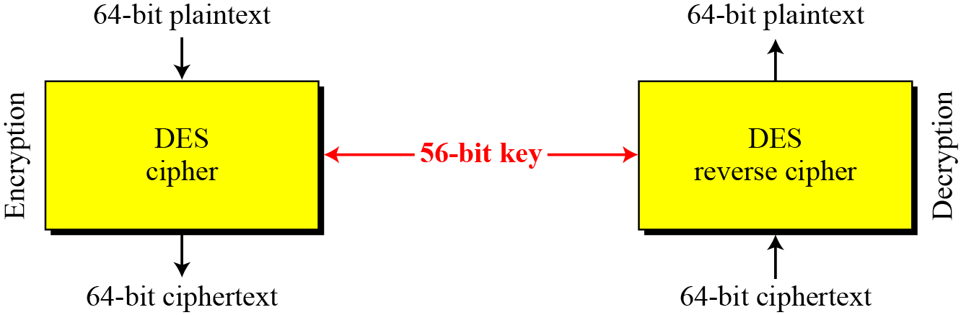
DES
DES is a block cipher
Encryption and decryption with DES
Notes:
At the encryption site, DES takes a 64-bit plaintext and creates a 64-bit ciphertext; at the decryption site, DES takes a 64-bit ciphertext and creates a 64-bit block of plaintext. The same 56-bit cipher key is used for both encryption and decryption.

Slide 10
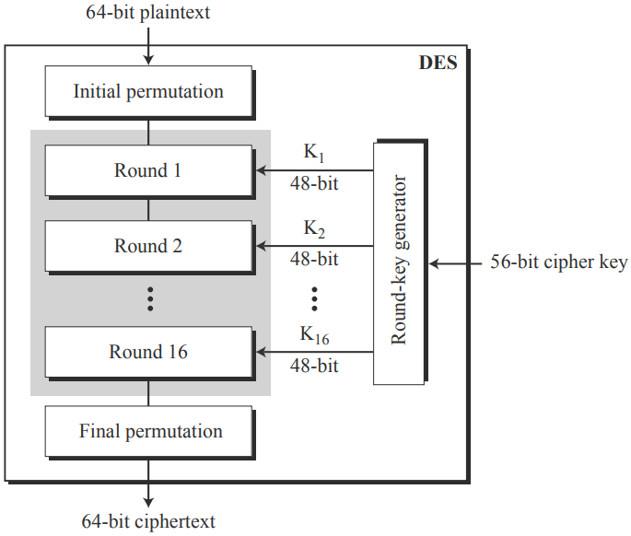
DES – Overview
Each round uses a different 48-bit round key generated from the cipher key according to a predefined algorithm
General structure of DES
Notes:
The encryption process is made of two permutations, which we call initial and final permutations, and sixteen Feistel rounds.
Each round uses a different 48-bit round key generated from the cipher key according to a predefined algorithm described later in the Lecture.

Slide 11
Many Questions You Want to Ask
How to perform Initial and Final Permutations?
How to perform each round?
How to generate sixteen 48-bit keys out of a 56-bit cipher key?

Slide 12
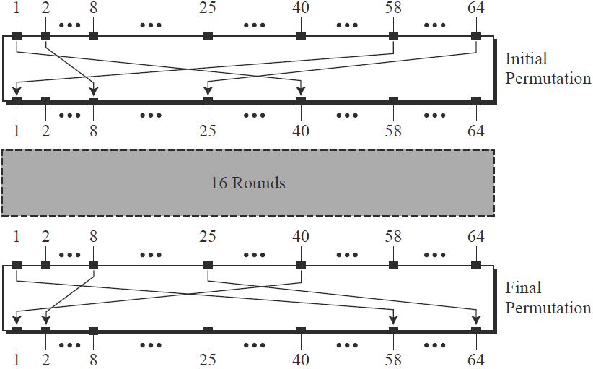
1st: Initial and Final Permutations
permutes them according to a predefined rule
Initial and final permutation steps in DES
Notes:
The above Figure shows the initial and final permutations. Each of these permutations takes a 64-bit input and permutes them according to a predefined rule. We have shown only a few input ports and the corresponding output ports.

Slide 13
1st: Initial and Final Permutations
keyless straight permutations that are the inverse of each other.
For example, in the initial permutation, the 58th bit in the input becomes the first bit in the output. Similarly, in the final permutation, the first bit in the input becomes the 58th bit in the output.

Slide 14
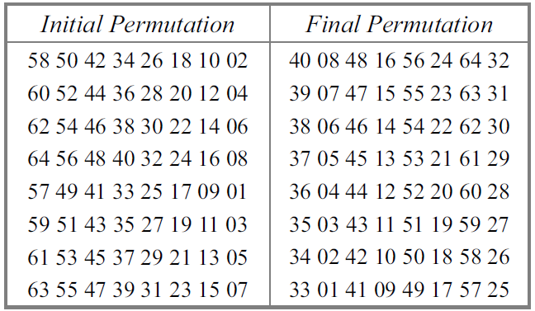
Initial and final permutation tables
The predefined permutation rules
The value of each element defines the input port number, and the order (index) of the element defines the output port number.

Slide 15
These two permutations have no cryptography significance in DES.
Both permutations are keyless and predetermined.
Why DES needs these two permutations?

Slide 16
Exercise 1 for Permutation
Find the output of the initial permutation when the input is given in hexadecimal as:
0x0002 0000 0000 0001
Write 0x0002 0000 0000 0001 in binary:
0000000000000010000000000000000000000000000000000000000000000001
The input has only two 1s (bit 15 and bit 64);
63
25
0000000000 0000000000 0000100000 0000000000 0000000000 0000000000 0010
The result in hexadecimal is: 0x0000 0080 0000 0002
Notes:
Bit 15 in the input becomes bit 63 in the output. Bit 64 in the input becomes bit 25 in the output.
So the output has only two 1s, bit 25 and bit 63.

Slide 17
Exercise 2 for Permutation
Prove that the initial and final permutations are the inverse of each other by finding the output of the final permutation if the input is:
0x0000 0080 0000 0002
The input has only two 1s (bit 25 and bit 63);
0000000000 0000000000 0000100000 0000000000 0000000000 0000000000 0010
64
15
0000000000000010000000000000000000000000000000000000000000000001
The result in hexadecimal is: 0x0002 0000 0000 0001
Notes:
Only bit 25 and bit 64 are 1s; the other bits are 0s.
In the final permutation, bit 25 becomes bit 64 and bit 63 becomes bit 15.

Slide 18
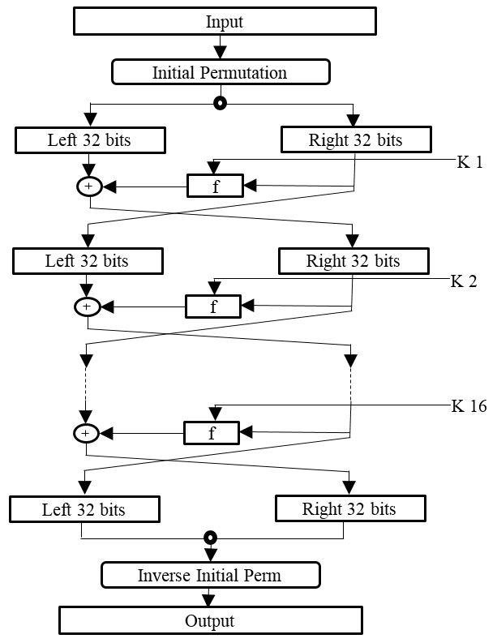
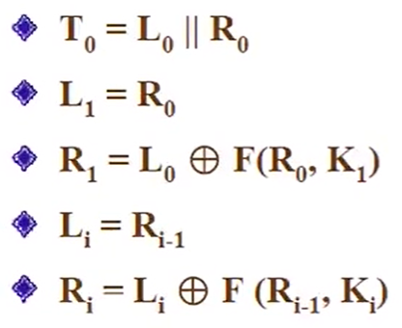
2nd: Rounds
Detailed General structure of DES

Slide 19
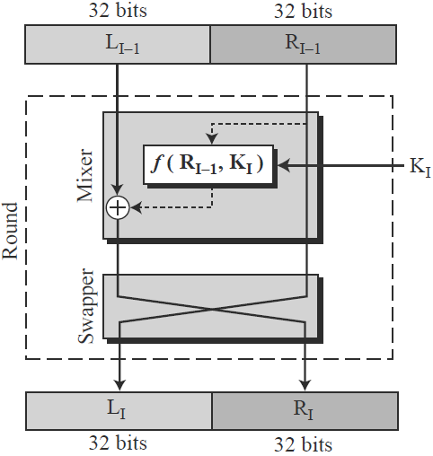
2nd: Rounds
Two cipher elements：
mixer and swapper
48-bit
Each of these elements is invertible
A round in DES (encryption site)
Notes:
The round takes LI−1 and RI−1 from previous round (or the initial permutation box) and creates LI and RI, which go to the next round (or final permutation box).
We can assume that each round has two cipher elements (mixer and swapper). Each of these elements is invertible. The swapper is obviously invertible. It swaps the left half of the text with the right half. The mixer is invertible because of the XOR operation. All noninvertible elements are collected inside the function f (RI−1, KI).

Slide 20
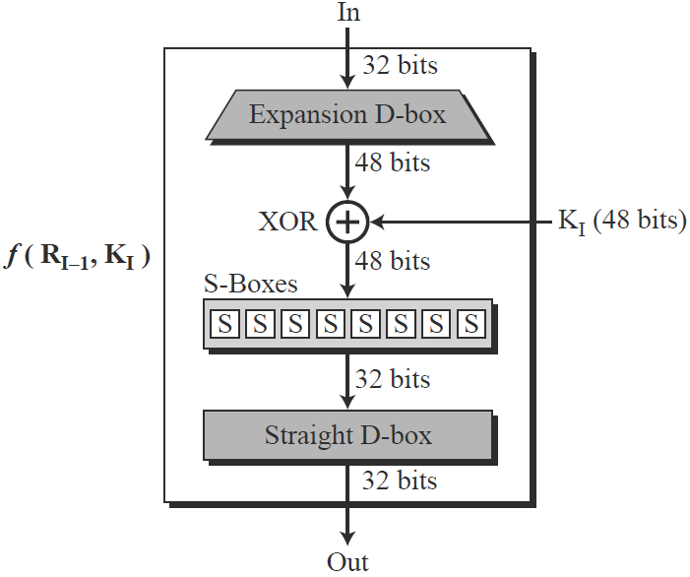
2nd: Rounds: DES Function
Function:
It applies a 48-bit key to the rightmost 32 bits (R_{I−1}) to produce a 32-bit output
3 steps:
Data expansion
Whitener (XOR)
S-Boxes

Slide 21
2nd: Rounds: DES Function - Data Expansion
Function:
Since R_{I−1} is a 32-bit input and K_{I} is a 48-bit key, we first need to expand R_{I−1} to 48 bits.
R_{I−1} is divided into eight 4-bit sections
Each 4-bit section is then expanded to 6 bits.
This expansion permutation follows a predetermined rule:
For each section, input bits 1, 2, 3, and 4 are copied to output bits 2, 3, 4, and 5, respectively.
Output bit 1 comes from bit 4 of the previous section; output bit 6 comes from bit 1 of the next section.

Slide 22
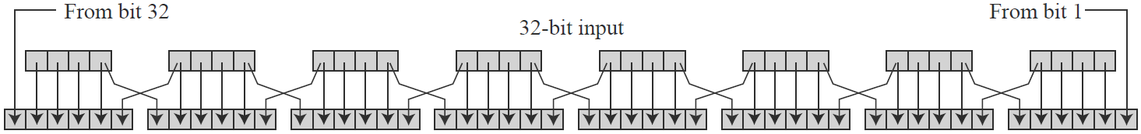
2nd: Rounds: DES Function - Data Expansion (Cont.)
Data Expansion

Slide 23
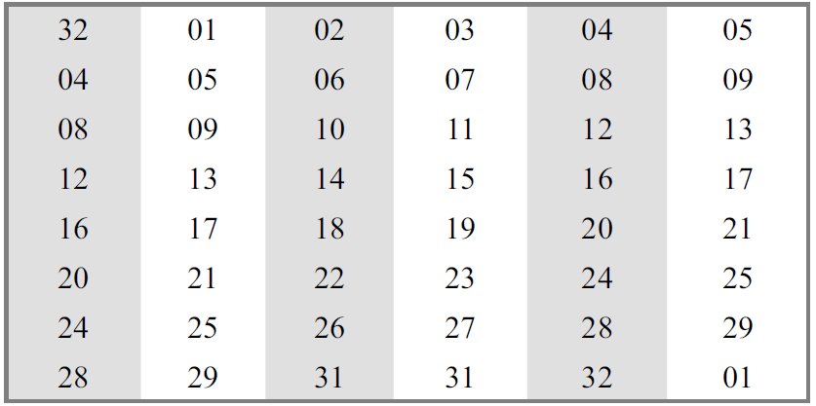
2nd: Rounds: DES Function - Data Expansion (Cont.)
Use a table to define such data expansion
Notes:
Although the relationship between the input and output can be defined mathematically, DES uses a Table to define this data expansion.
Note that the number of output ports is 48, but the value range is only 1 to 32. Some of the inputs go to more than one output. For example, the value of input bit 5 becomes the value of output bits 6 and 8.

Slide 24
Exercise for Data Expansion
Given R_{I−1} as:
0001 0011 1001 1110 1011 0000 0000 0001
What’s the result after expanding 32-bit input to 48-bit output?
100010 100111 … …

Slide 25
2nd: Rounds: DES Function - Whitener (XOR)
Function:
After the data expansion, DES uses the XOR operation on the expanded right section and the round key.
Expended R_{I−1}:
1000 1010 0111 … …
key:
1101 0010 0001 … …
XOR:
0101 1000 0110 … …
Notes:
After the expansion, DES uses the XOR operation on the expanded right section and the round key. Note that both the right section and the key are 48-bits in length. Also note that the round key is used only in this operation.

Slide 26
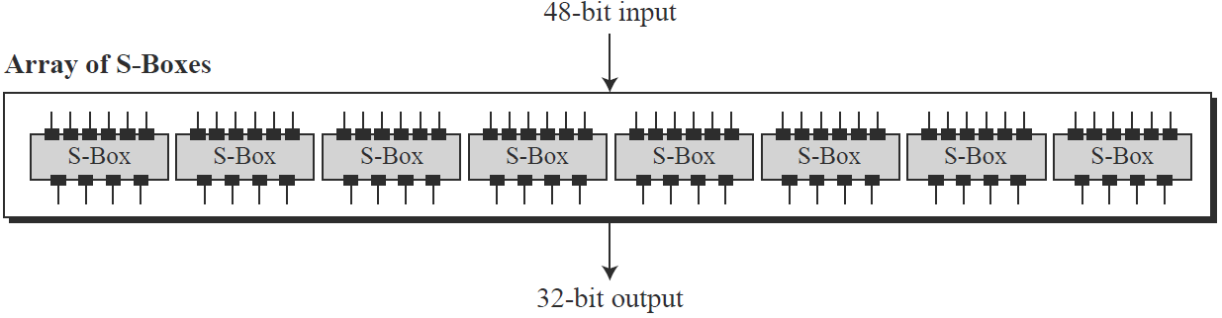
2nd: Rounds: DES Function - S-boxes (Data Compression)
Function:
Because the output of one round should be 32 bits, not 48 bits
DES uses 8 S-boxes, each with a 6-bit input and a 4-bit output
Notes:
The 48-bit data from the second operation is divided into eight 6-bit chunks, and each chunk is fed into a box.
The result of each box is a 4-bit chunk; when these are combined the result is a 32-bit text.

Slide 27
2nd: Rounds: DES Function - S-boxes (Data Compression) (cont.)
The substitution in each box follows a pre-determined rule based on a 4-row by 16-column table
The combination of bits 1 and 6 of the input defines one of four rows
The combination of bits 2 through 5 defines one of the sixteen columns

Slide 28
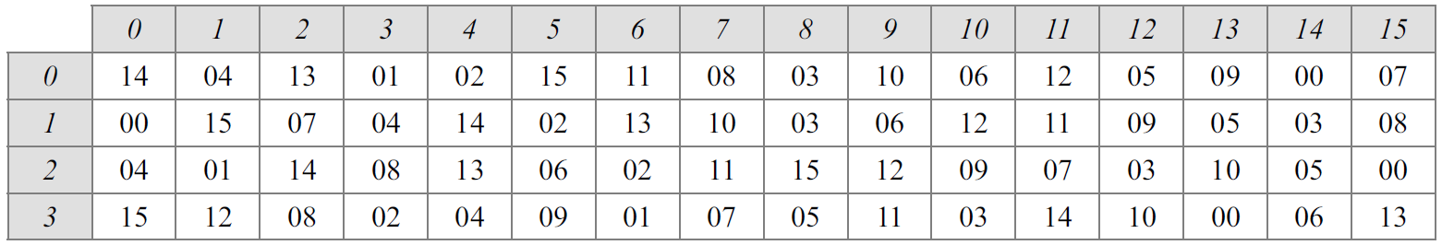
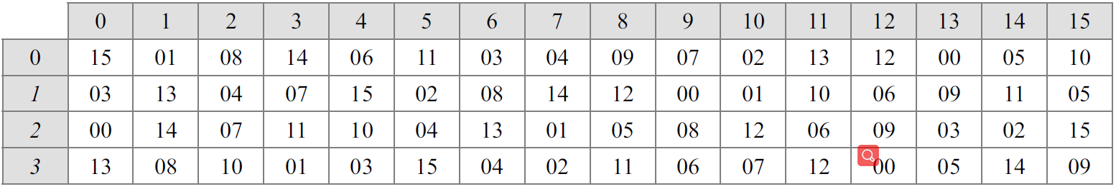
2nd: Rounds: DES Function - S-boxes (cont.)
Because each S-box has its own table, we need eight tables:
S-box 1
S-box 2
Notes:
The values of the inputs (row number and column number) and the values of the outputs are given as decimal numbers to save space. These need to be changed to binary.

Slide 29
Exercise 1
The input to S-box 1 is 100011. What is the output?
Solution:
If we write the first and the sixth bits together, we get 11 in binary, which is 3 in decimal
The remaining bits are 0001 in binary, which is 1 in decimal
We look for the value in row 3, column 1, in S-box 1
The result is 12 in decimal, which in binary is 1100. So the input 100011 yields the output 1100

Slide 30
Exercise 2
The input to S-box 2 is 000000. What is the output?
Solution:
If we write the first and the sixth bits together, we get 00 in binary, which is 0 in decimal
The remaining bits are 0000 in binary, which is 0 in decimal. We look for the value in row 0, column 0, in S-box 2
The result is 15 in decimal, which is 1111 in binary. So the input 000000 yields the output 1111

Slide 31
2nd: Rounds: Output of Function XOR L_{i-1}
Output of f(R_{i-1}, K_{i}):
1000 1010 0111 … …
L_{i-1}:
1101 0010 0001 … …
XOR:
0101 1000 0110 … …

Slide 32
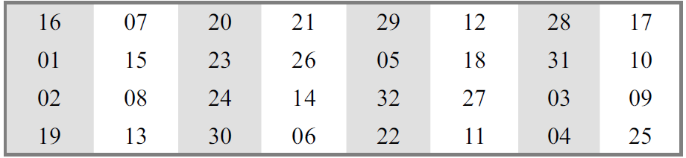
Final Permutation
Just perform permutation after all rounds
Function:
A permutation with a 32-bit input and a 32-bit output
For example, the seventh bit of the input becomes the second bit of the output

Slide 33
Example of DES Encryption
We do it together!
Plaintext: 0002050000400001 (it is hexadecimal!)
Key: 1000 0000 0000 0101 0000 0000 0001 0001 1000 0000 0000 1000 (Assume it is given as 48 bits)
Ciphertext: ?
Encryption method: DES
Initial permutation
16 rounds
Data expansion
Whitener (XOR)
S-Boxes
Final permutation

Slide 34
Step 1: Initial Permutation
Plaintext: 0002050000400001 (it is hexadecimal!)
Transferred to Binary:
0000 0000 0000 0010 0000 0101 0000 0000
0000 0000 0100 0000 0000 0000 0000 0001
15
22
24
42
64
It is 64 bits.
What’s the position of each “1”?

Slide 35
Step 1: Initial Permutation (Cont.)
15
22
24
0000 0000 0000 0010 0000 0101 0000 0000
0000 0000 0100 0000 0000 0000 0000 0001
42
64
3
22
30
25
63

Slide 36
Step 1: Initial Permutation (Cont.)
3
22
30
25
63
3
22
25
30
0010 0000 0000 0000 0000 0100 1000 0100
0000 0000 0000 0000 0000 0000 0000 0010
63

Slide 37
Step 2: 16 Rounds
After initial permutation:
0010 0000 0000 0000 0000 0100 1000 0100
0000 0000 0000 0000 0000 0000 0000 0010
After splitting:
L₀ = 0010 0000 0000 0000 0000 0100 1000 0100
R₀ = 0000 0000 0000 0000 0000 0000 0000 0010
What’s the value of L₁?
it is L₁ = R₀
What’s the value of R₁?
it is

Slide 38
Step 2.1: Data Expansion
Expand R₀ from 32 bits to 48 bits:
R₀ = 0000 0000 0000 0000 0000 0000 0000 0010
After expand R₀:
R₀’ = 000000 000000 000000 000000 000000 000000 000000 000100

Slide 39
Step 2.2: XOR
Binary:
K = 100000 000000 000101 000000 000001 000110 000000 000010
R₀’ = 000000 000000 000000 000000 000000 000000 000000 000100
Y = 100000 000000 000101 000000 000001 000110 000000 000110

Slide 40
Step 2.3: S-boxes (Data Compression)
Binary:
K = 100000 000000 000101 000000 000001 000110 000000 000010
R₀’ = 000000 000000 000000 000000 000000 000000 000000 000100
Y = 100000 000000 000101 000000 000001 000110 000000 000110
100000 000000 000101 000000 000001 000110 000000 000110
0
0
2
0
0
3
0
3
1
0
1
0
1
0
0
0

Slide 41
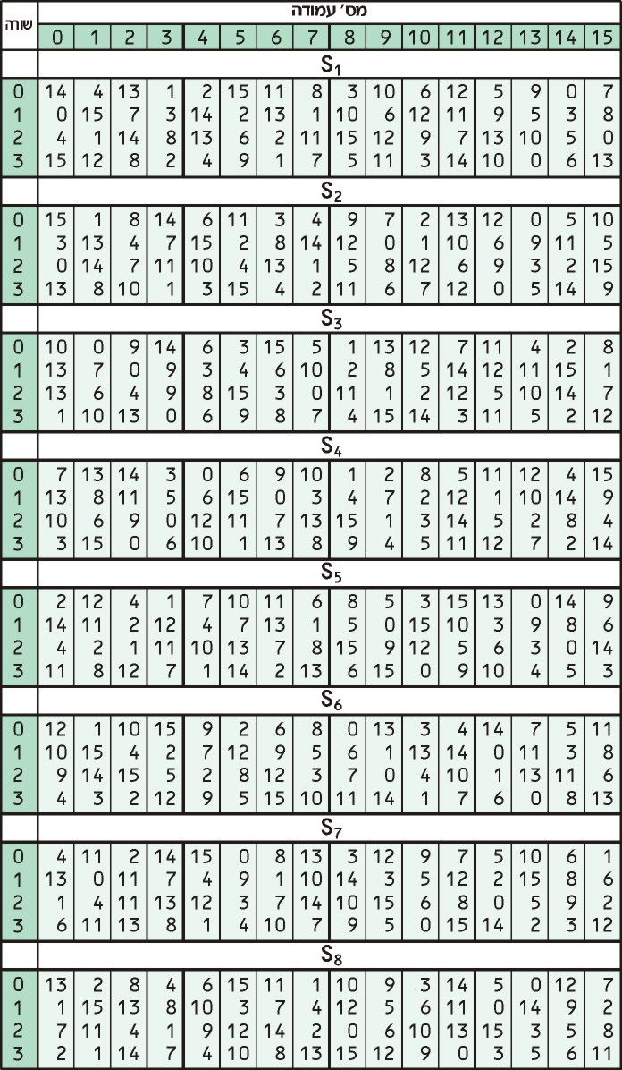

Slide 42
Step 3: Output of Function XOR L_{i-1}
Output of f(R_{i-1}, K_{i}):
1000 1010 0111 … …
L_{i-1}:
1101 0010 0001 … …
XOR:
0101 1000 0110 … …
What’s the value of L₁?
it is L₁ = R₀
What’s the value of R₁?
it is

Slide 43
3rd: Key Generation
Function:
Creates sixteen 48-bit keys out of a 56-bit cipher key
a 64-bit key in which 8 extra bits are the parity bits, which are dropped before the actual key-generation process.
Parity Drop: It drops the parity bits (bits 8, 16, 24, 32, …, 64) from the 64-bit key and permutes the rest of the bits according to pre-defined rule.
The remaining 56-bit value is the actual cipher key which is used to generate round keys

Slide 44
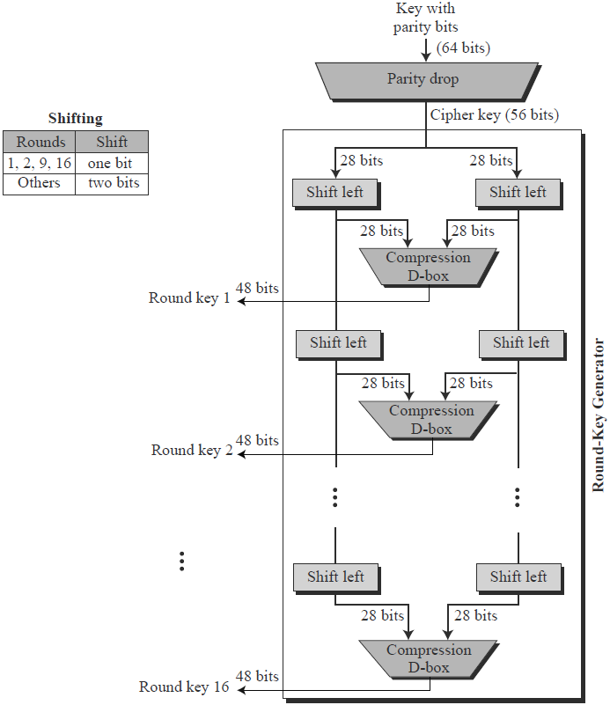
3rd: Key Generation

Slide 45
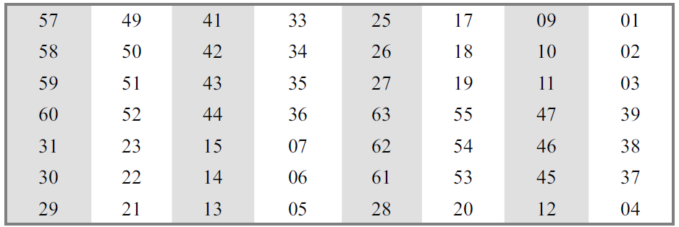
3rd: Key Generation - Parity Drop
Function:
Creates sixteen 48-bit keys out of a 56-bit cipher key
Step1:
It drops the parity bits (bits 8, 16, 24, 32, …, 64) from the 64-bit key and permutes the rest of the bits according to predefined rule
Parity-bit drop table
It drops the parity bits (bits 8, 16, 24, 32, …, 64) from the 64-bit key and permutes the rest of the bits according to pre-defined rule.

Slide 46
3rd: Key Generation - Shift Left
After the straight permutation, the key is divided into two 28-bit parts
Each part is shifted left (circular shift) one or two bits
In rounds 1, 2, 9, and 16, shifting is one bit; in the other rounds, it is two bits
The two parts are then combined to form a 56-bit part
Number of bit shifts

Slide 47
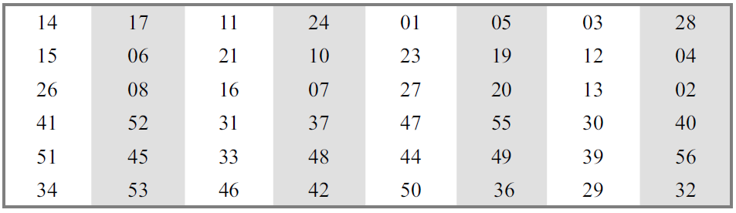
3rd: Key Generation - Compression
Function:
Changes the 56 bits to 48 bits, which are used as a key for a round

Slide 48
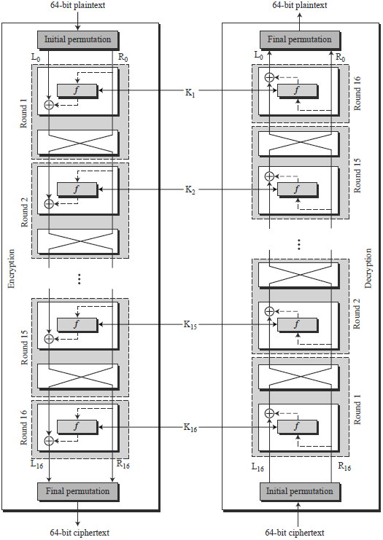
DES Decryption
Same as the encryption algorithm with the “reversed” key schedule
Notes:
A very important point we need to remember about the ciphers is that the round keys (K1 to K16) should be applied in the reverse order. At the encryption site, round 1 uses K1 and round 16 uses K16; at the decryption site, round 1 uses K16 and round 16 uses K1.

Slide 49
Summary of DES
Cipher Iterative Action :
Input: 64 bits
Key: 48 bits
Output: 64 bits
Key Generation Box :
Input: 56 bits
Output: 48 bits
One round (Total 16 rounds)

Slide 50
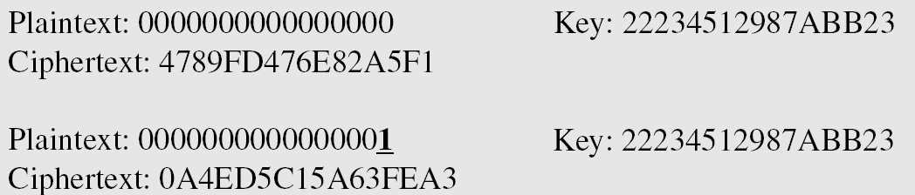
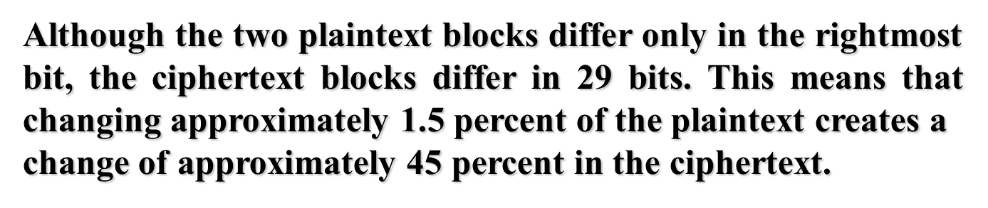
DES Security: Avalanche Effect

Slide 51
DES Security: Avalanche Effect
If a block cipher does not exhibit the avalanche effect to a significant degree, then it has poor randomization, and thus a cryptanalyst can make predictions about the input, being given only the output.
This may be sufficient to partially or completely break the algorithm. Thus, the avalanche effect is a desirable condition from the point of view of the designer of the cryptographic algorithm or device.

Slide 52
Attacks on DES

Slide 53
Multiple Encryption with DES
DES is not secure enough.
The once large key space, 2⁵⁶, is now too small.
In 2001, NIST published the Advanced Encryption Standard (AES) as an alternative.
But users in commerce and finance are not ready to give up on DES.
Solution: to use multiple DES with multiple keys
The speed of exhaustive key searches against DES after 1990 began to cause discomfort amongst users of DES
Notes:
However, users did not want to replace DES as it takes an enormous amount of time and money to change encryption algorithms that are widely adopted and embedded in large security architectures.
The pragmatic approach was not to abandon the DES completely, but to change the manner in which DES is used. This led to the modified schemes of Triple DES (sometimes known as 3DES).

Slide 54
Exhaustive Search for block cipher key
Goal: given a few input output pairs
(m_{i}, c_{i} = E(k, m_{i})) i = 1, …, n find key k.
Attack: Brute force to find the key k.

Slide 55
DES Security
⇒ 56-bit ciphers should not be used (128-bit key ⇒ 2⁷² days)
1976 | DES adopted as federal standard
1997 | Distributed search | 3 months
1998 | EFF deep crack | 2.5 days | $250,000
1999 | Distributed search | 22 hours
2006 | COPACOBANA (120 FPGAs) | 7 days | $10,000
The DES algorithm was broken in 1998 using a system that cost about $250,000.

Slide 56
Strengthening DES

Slide 57
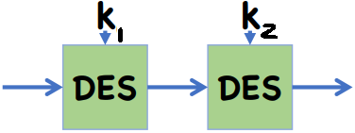
Double-DES (2DES)
Consider 2-DES with two keys:
C = E_{K2}(E_{K1}(P))
Decryption: P = D_{K2}(D_{K1}(C))
Key length: 56 x 2 = 112 bits
Brute force attack running time: 2¹¹²
This should have thwarted brute-force attacks?
Wrong!
p
E_{K1}(P)
C

Slide 58
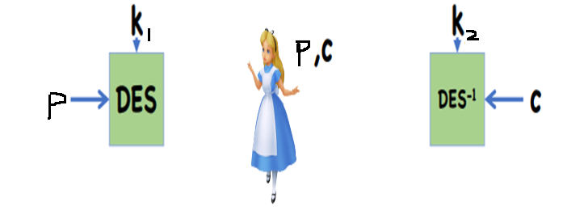
Meet-in-the-Middle Attack on 2DES
p
E_{K1}(P)
C
2-DES: C = E_{K2}(E_{K1}(P))
So, E_{K1}(P) = D_{K2}(C)

Slide 59
Meet-in-the-Middle Attack on 2DES
2-DES: C = E_{K2}(E_{K1}(P))
So, E_{K1}(P) = D_{K2}(C)
Given a known pair (P, C), attack as follows:
Encrypt P with all 2⁵⁶ possible keys for K1.
Decrypt C with all 2⁵⁶ possible keys for K2.
If E_{K1’}(P) = D_{K2’}(C), try the keys on another (P’, C’).
If works, (K1’, K2’) = (K1, K2) with high probability.
Takes O(2⁵⁶) steps; not much more than attacking 1-DES.

Slide 60
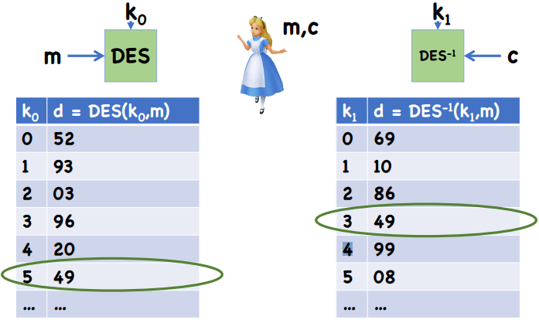
Meet-in-the-Middle Attack on 2DES

Slide 61
Triple DES (3DES) with 2 Keys or 3 Keys
A straightforward implementation would be:
C = E_{K1}(E_{K2}(E_{K1}(P))) or
C = E_{K3}(E_{K2}(E_{K1}(P)))
Should these two have thwarted brute-force attacks?

Slide 62
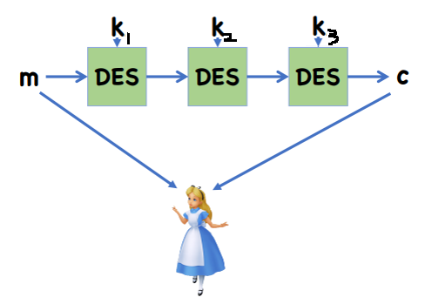
MITM Attacks on 3DES with 3 keys

Slide 63
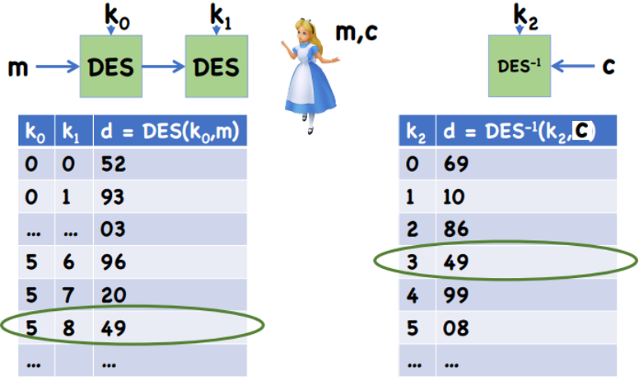
MITM Attacks on 3DES with 3 Keys

Slide 64
Triple DES with 2 Keys
In practice: C = E_{K1}(D_{K2}(E_{K1}(P)))
Also referred to as EDE encryption
If K1=K2, then 3DES = 1DES. Thus, a 3DES software can be used as a single-DES.
What about the meet-in-the-middle attack?

Slide 65
Meet-in-the-Middle Attack on 3DES with 2 Keys
K1 K2 K1
A B
P C
E D E
For each possible key for K1, encrypt P to produce a possible value for A.
Using this A, and C, attack the 2DES to obtain a pair of keys (K2, K1’).
If K1’ = K1, try the key pair (K1, K2) on another (C’,P’).
If it works, (K1, K2) is the key pair with high probability.
It takes O(2⁵⁶ x 2⁵⁶) = O(2¹¹²) steps on average.

Slide 66
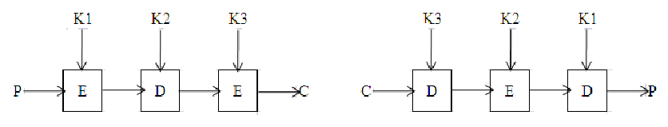
Triple DES with 3 Keys
Encryption: C = E_{K3}(D_{K2}(E_{K1}(P)))
If K1 = K3, we have 3DES with 2 keys.
If K1 = K2 = K3, we have the regular DES.
So, 3DES w/ 3keys is backward compatible with 3DES w/ 2 keys and with the regular DES
What about the meet-in-the-middle attack?
How many steps are needed?

Slide 67
Block ciphers
AES – Advanced Encryption Standard
Like DES, AES is a symmetric block cipher. This means that it uses the same key for both encryption and decryption.

Slide 68
The AES process
1997: DES broken by exhaustive search
1997: NIST publishes request for proposal
1998: 15 submissions
1999: NIST chooses 5 finalists
2000: NIST chooses Rijndael as AES (developed by Daemen and Rijmen at K.U. Leuven, Belgium)
It is found at least six time faster than triple DES.
Notes:
The National Institute of Standards and Technology (NIST) set up a contest.
In the first round of the competition, 15 algorithms were accepted, and this was narrowed to 5 in the second round.
Triple DES on the other hand, has three times as many rounds as DES and is correspondingly slower.
As well as this, the 64 bit block size of triple DES and DES is not very efficient and is questionable when it comes to security.

Slide 69
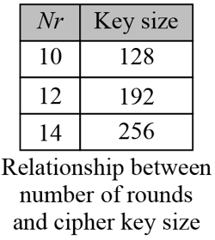
AES
AES is a cipher that encrypts and decrypts a data block of 128 bits.
It uses 10, 12, or 14 rounds.
The key size, which can be 128, 192, or 256 bits, depends on the number of rounds
Notes:
The algorithm can only accept a block size of 128 bits and a choice of three keys - 128, 192, 256 bits.
Depending on which version is used, the name of the standard is modified to AES-128, AES-192 or AES-256 respectively.
At present the most common key size likely to be used is the 128 bit key.

Slide 70
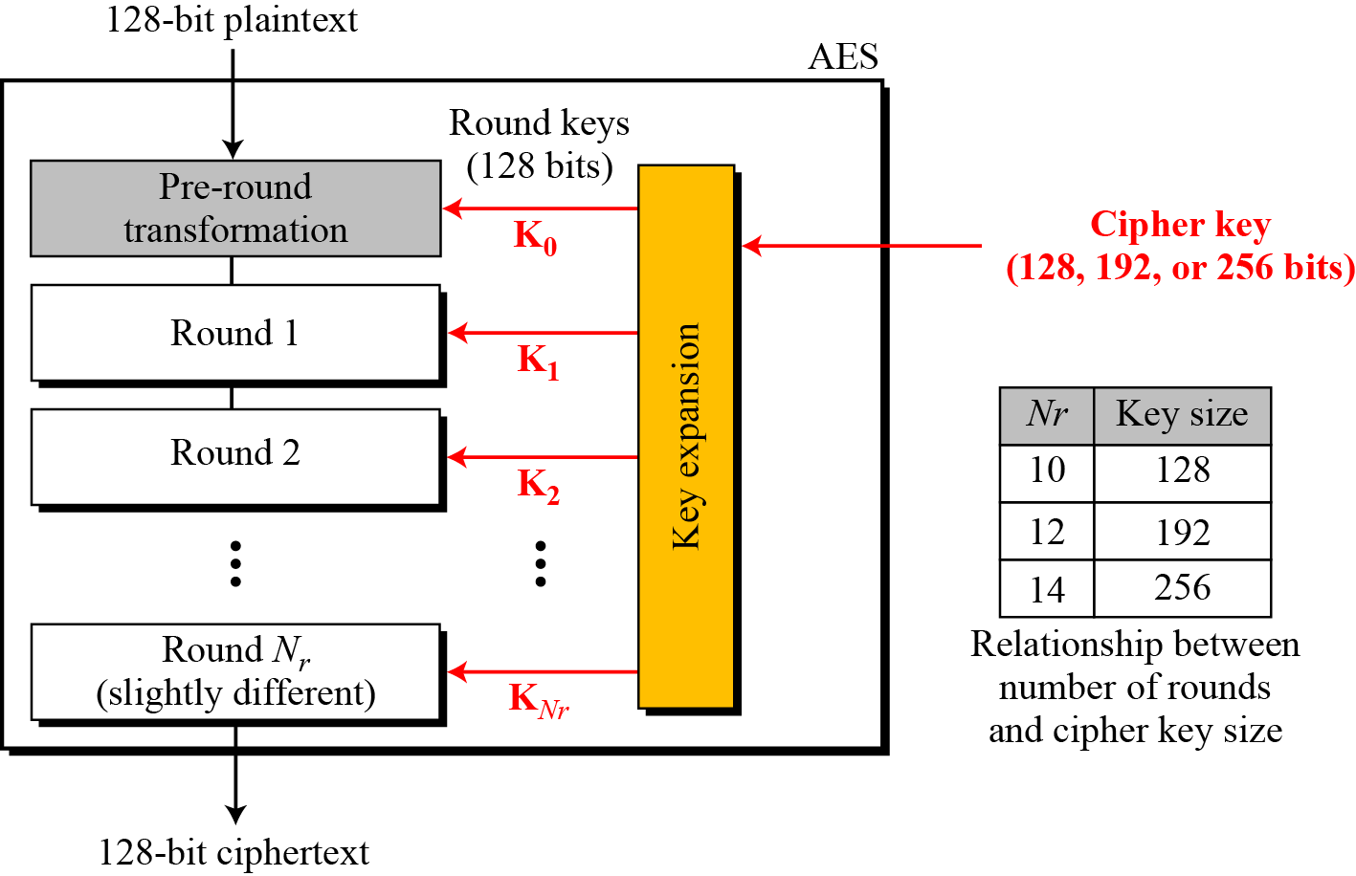
AES: Structure
Notes:
One byte contains eight binary bits
As well as these differences AES differs from DES in that it is not a feistel structure.
Recall that in a feistel structure, half of the data block is used to modify the other half of the data block and then the halves are swapped.
In this case the entire data block is processed in parallel during each round using substitutions and permutations.

Slide 71
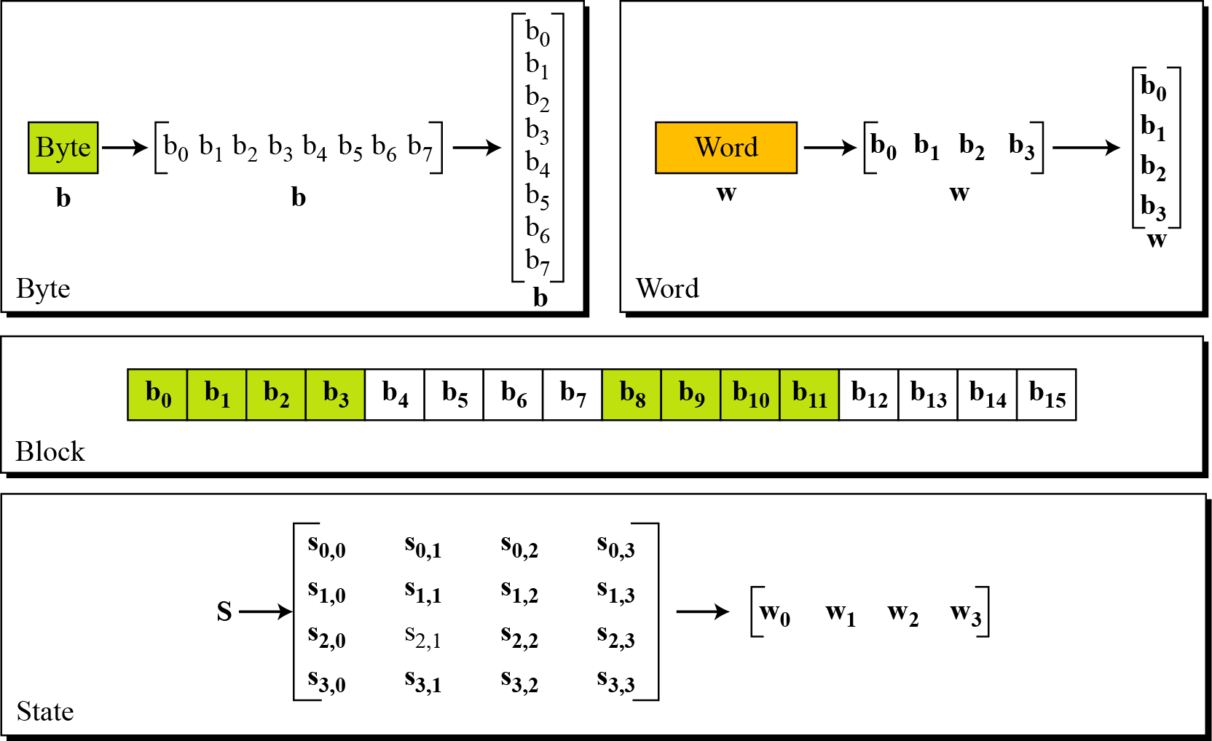
Preparation: Data Units Used in AES

Slide 72
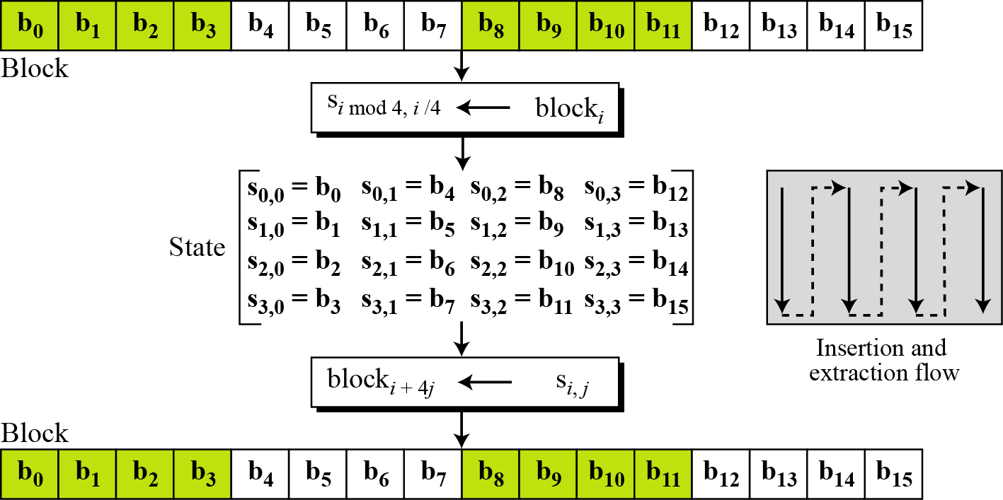
Preparation: Data Units Used in AES (Cont.)
Block-to-state and state-to-block transformation

Slide 73
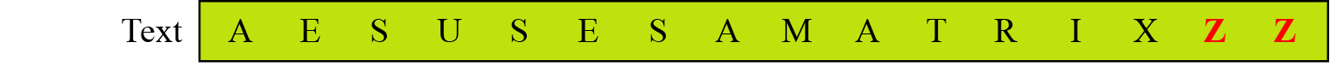
Preparation: Data Units Used in AES (Cont.)
Block-to-state and state-to-block transformation
41 45 53 55 53 45 53 41 4D 41 54 52 49 58 5A 5A
41 53 4D 49
45 45 41 58
53 53 54 5A
55 41 52 5A
State

Slide 74
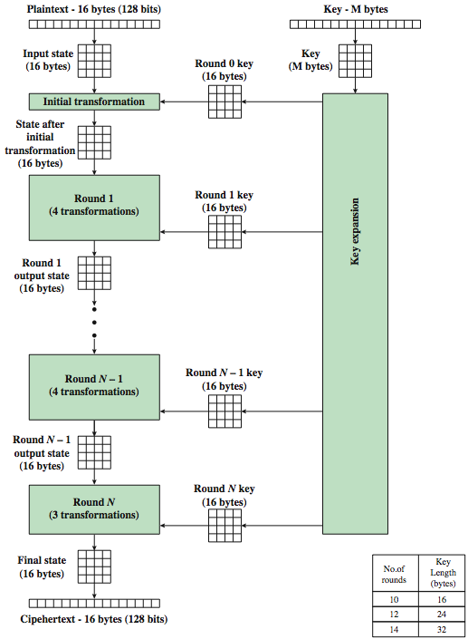
AES Encryption Process

Slide 75
AES-128 schematic
10 rounds
4
ByteSub
ShiftRow
MixColumn
ByteSub
ShiftRow
MixColumn
ByteSub
ShiftRow
input
⊕
⊕
⊕
⊕
4
• • •
k₀
k₁
k₂
k₉
⊕
4
k₁₀
output
4
4
key
4

Slide 76
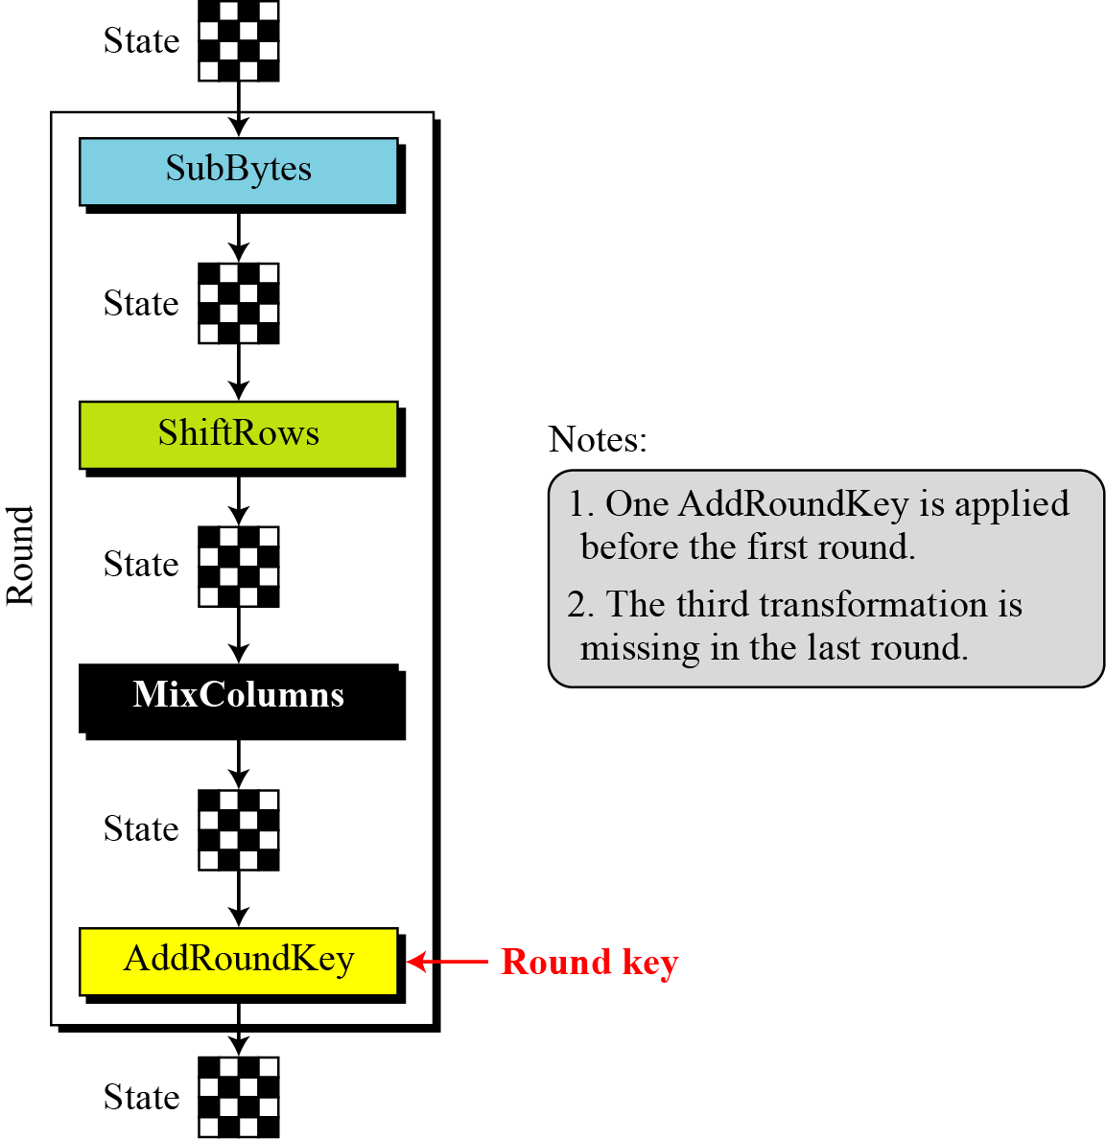
Structure of Each Round
Structure of each round at the encryption site

Slide 77

7.2.1 Substitution
AES, like DES, uses substitution. AES uses two invertible substitution.
SubBytes
The first substitution, SubBytes, is used at the encryption site. To substitute a byte, we interpret the byte as two hexadecimal digits.
Note
The SubBytes operation involves 16 independent byte-to-byte transformations.

Slide 78
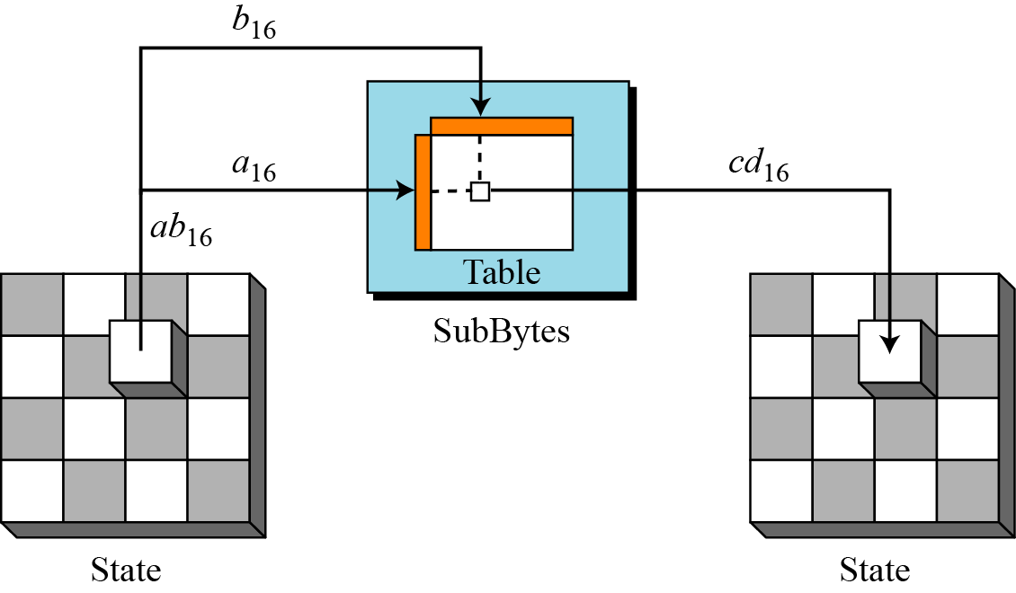
7.2.1 Substitution
Figure 7.6 SubBytes transformation
Notes:
The s-box is designed to be resistant to known cryptanalytic attacks.
Specifically, the AES developers sought a design that has a low correlation between input bits and output bits, and the property that the output cannot be described as a simple mathematical function of the input.

Slide 79
7.2.1 Substitution

Slide 80
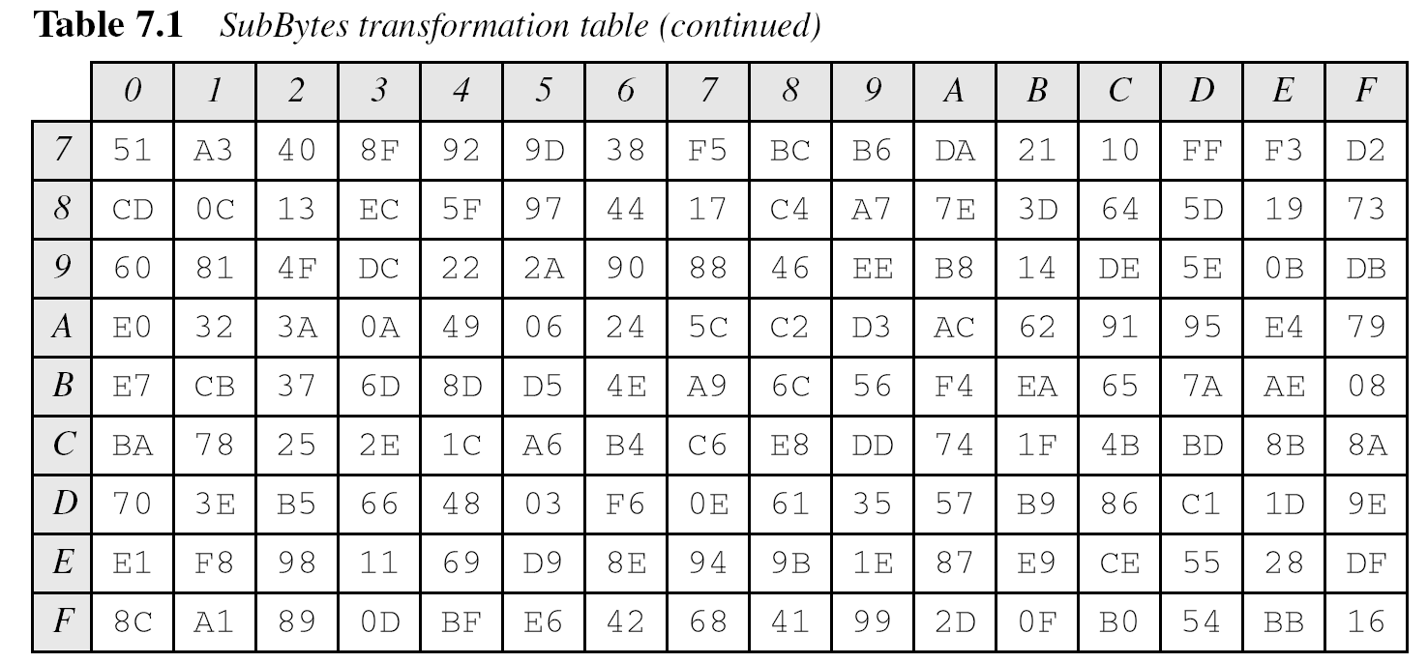
7.2.1 Substitution

Slide 81
7.2.1 Substitution
InvSubBytes

Slide 82
7.2.1 Substitution
InvSubBytes (Continued)

Slide 83
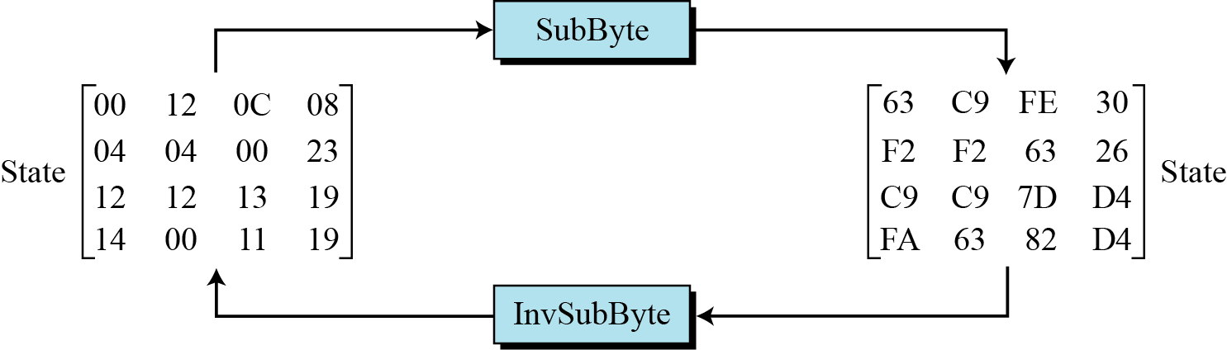
7.2.1 Substitution
Example 7.2
Figure 7.7 shows how a state is transformed using the SubBytes transformation. The figure also shows that the InvSubBytes transformation creates the original one.
Figure 7.7 SubBytes transformation for Example 7.2

Slide 84
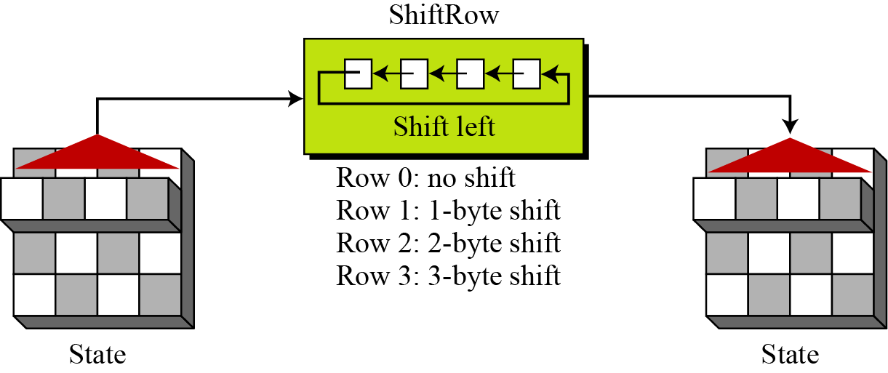
7.2.2 Permutation
Another transformation found in a round is shifting, which permutes the bytes.
ShiftRows
In the encryption, the transformation is called ShiftRows.
Figure 7.9 ShiftRows transformation
Notes:
The first row of state is not altered.
The second row is shifted 1 bytes to the left in a circular manner.
The third row is shifted 2 bytes to the left in a circular manner.

Slide 85
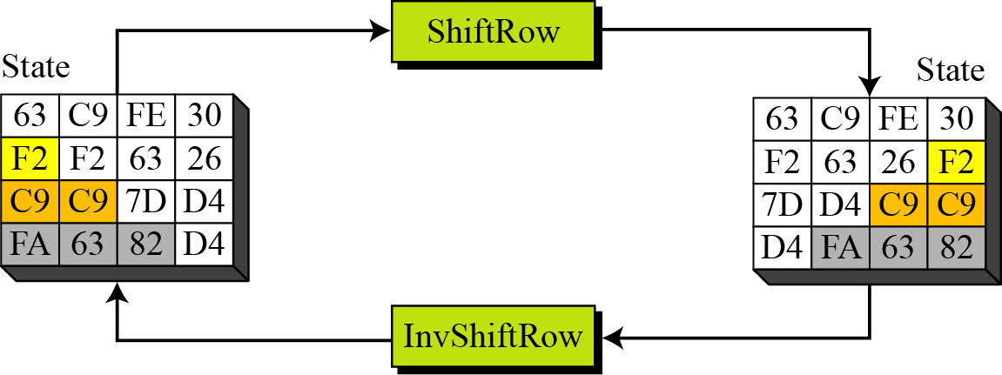
7.2.2 Permutation
Example 7.4
Figure 7.10 shows how a state is transformed using ShiftRows transformation. The figure also shows that InvShiftRows transformation creates the original state.
The transformation ensures that the four bytes of one column are spread out to four different columns.
Figure 7.10 ShiftRows transformation in Example 7.4
Notes:
This operation may not appear to do much but if you think about how the bytes are ordered within state then it can be seen to have far more of an impact.
Remember that state is treated as an array of four byte columns, i.e. the first column actually represents bytes 1, 2, 3 and 4. A one byte shift is therefore a linear distance of four bytes.

Slide 86
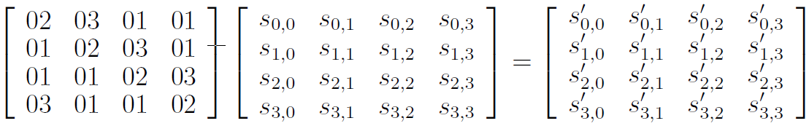
7.2.3 Mixing
Each column is operated on individually
Each byte of a column is mapped into a new value that is a function of all four bytes in the column.
Figure 7.11 Mixing bytes using matrix multiplication

Slide 87
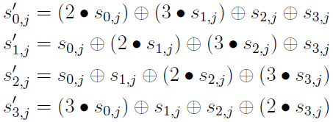
7.2.3 Mixing
Example 7.5

Slide 88
7.2.4 Key Adding
AddRoundKey
In this stage (known as AddRoundKey) the 128 bits of state are bitwise XORed with
the 128 bits of the round key. The operation is viewed as a column-wise operation
between the 4 bytes of a state column and one word of the round key.
Note
The AddRoundKey transformation is the inverse of itself.

Slide 89
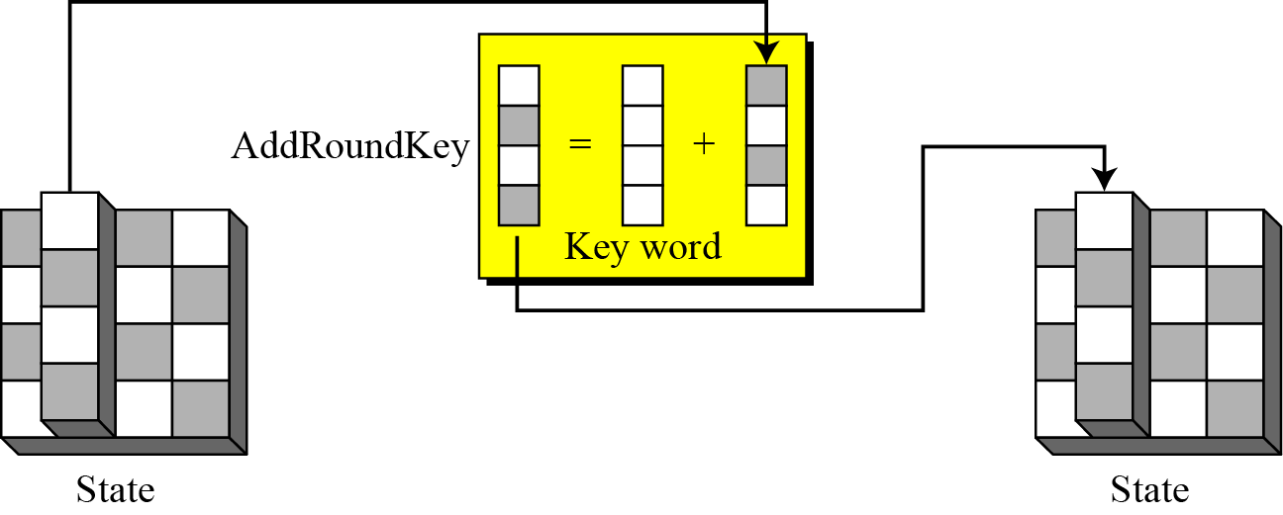
7.2.4 Continue
Figure 7.15 AddRoundKey transformation

Slide 90

AES Example - Input (128 bit key and message)
Key in Hex (128 bits):
54 68 61 74 73 20 6D 79 20 4B 75 6E 67 20 46 75
Plaintext in English:
“Two One Nine Two” (16 ASCII characters, 1 byte each)
Plaintext in Hex (128 bits):
54 77 6F 20 4F 6E 65 20 4E 69 6E 65 20 54 77 6F

Slide 91
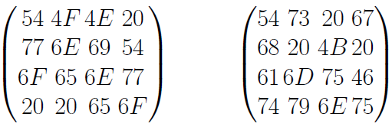
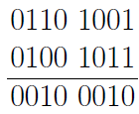
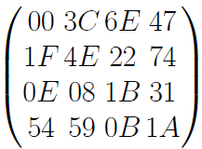
AES Example - Add Roundkey, Round 0
State Matrix and Roundkey
XOR the corresponding entries, e.g., 69 ⊕ 4B = 22
After XOR, the new State Matrix is:

Slide 92
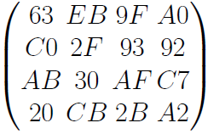
AES Example - Round 1, Substitution Bytes
Current State Matrix is:
Substitute each entry (byte) of current state matrix by corresponding entry in AES S-Box
For instance: byte 6E is substituted by entry of S-Box in row 6 and column E, i.e., by 9F
This leads to new State Matrix:
Notes:
this non-linear layer is for resistance to differential and linear cryptanalysis attacks.

Slide 93
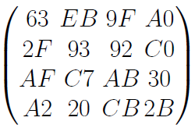
AES Example - Round 1, Shift Row
Current State Matrix is:
Four rows are shifted cyclically to the left by offsets of 0, 1, 2, and 3
The new State Matrix is
Notes:
this linear mixing step causes diffusion of the bits over multiple rounds

Slide 94
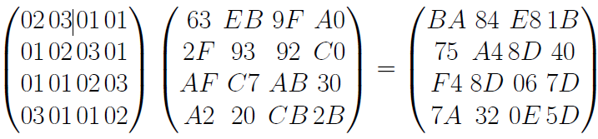
AES Example - Round 1, Mix Column
Mix Column multiplies fixed matrix against current State Matrix:
Entry BA is result of:
(02 X 63) ⊕ (03 X 2F) ⊕ (01 X AF) ⊕ (01 X A2);

Slide 95


AES Example - Add Roundkey, Round 1
State Matrix and Roundkey No.1 Matrix:
XOR yields new State Matrix
AES output after Round 1: 58 47 08 8B 15 B6 1C BA 59 D4 E2 E8 CD 39 DF CE

Slide 96
7.6.1 Security
AES was designed after DES. Most of the known attacks on DES were already tested on AES.
Brute-Force Attack
AES is definitely more secure than DES due to the larger-size key.
Statistical Attacks
Numerous tests have failed to do statistical analysis of the ciphertext.

Slide 97
7.6.3 Simplicity and Cost
The algorithms used in AES are so simple that they can be easily implemented using cheap processors and a minimum amount of memory.

Slide 98
Example of Confusion and Diffusion
Which encryption has higher confusion or diffusion?
Current State Matrix is:
Substitute each entry (byte) of current state matrix by some entry.
The following shows the other substitute:
$ 53 & b
23 A ^ 2B
EF ( @ 6
@ D 1 %

Slide 99

Example of Confusion and Diffusion
Which encryption has higher confusion or diffusion?
Current State Matrix is:
Four rows are shifted cyclically to the left by offsets of 0, 1, 2, and 3
Four rows and columns are shifted cyclically to the left and up by offsets of 0, 1, 2, and 3
2F AF A2
C0 30 2B A0
AB CB 9F 92
20 EB 93 C7

Slide 100
Reading
http://web.cs.ucdavis.edu/~rogaway/classes/227/spring05/book/main.pdf (Chapter 3)
http://kathrynneugent.com/animation.html
https://www.youtube.com/watch?v=mlzxpkdXP58

